Slide 1
CSmith for HLS Compilers
Presented by: William O’Brien, Emily Kao, Samuel Lee, Jason Panelli

Slide 2
Motivation
What is high-level synthesis (HLS)?
Methodology that transforms a behavioral description into a register-transfer level structure
HLS Testing for FPGA Development
Not many tools available for HLS fuzzing
CSmith as a potential solution
A random generator of C programs
CSmith is specific to C code generation, it is not trivial to extend it to other languages.
HLS accepts a subset of C
Hypothesis: CSmith can be extended to generate random programs that can be directed towards finding HLS compiler bugs
Notes:
Sam
Explain HLS, discuss the importance of it and it’s growth in popularity for FPGA development.
Hardware programming professionals now rely on HLS more than ever before, but there are not many tools available for HLS fuzzing. This would be important to have to ensure quality and assurance for FPGA development.
Which leads us to Csmith - mention to the class that if they remember, CSmith is a random C program generator that was presented during our class presentations. It is specific to C code generation, however since HLS accepts a subset of C as input, we hypothesize that Csmith can be extended to generate random programs that can be directed towards finding HLS compiler bugs.

Slide 3
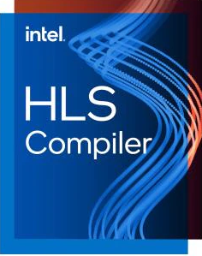
Approach
HLS compiler setup
Instant SOC
ROCCC
Intel i++ and dpcpp
Not all compilers were feasible options
Notes:
Sam
Talk about how we started with looking for HLS compilers that we could get installed on our machines in order to run Csmith programs on them to get a good idea of feasibility. We looked into compilers like Instant SOC, ROCCC, Intel i++, and more. This was a lengthy process as we found that some compilers were not suitable for C, and some required us to purchase the software, or some software was just outdated. We ended up going with the intel HLS compiler.

Slide 4
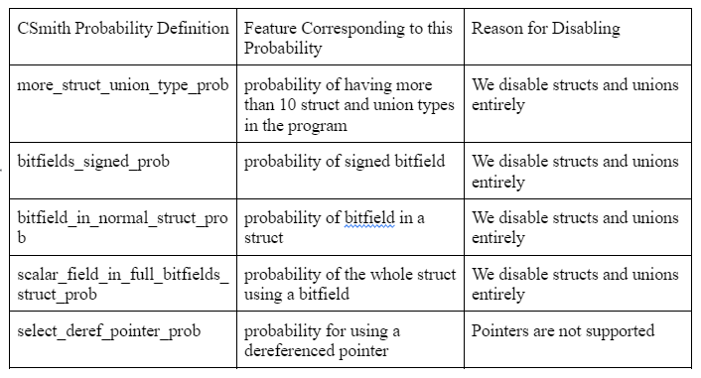
Methodology
How does CSmith’s probability-based generation work?
Applies probabilities to grammar rules
Modification of CSmith probability file
Restrict CSmith to the subset of C that HLS uses
Unsupported C99 features
disabled from CSmith generation
Notes:
@Jason Panelli
Talk about CSmith probability based generation. Talk about why we need to modify CSmith probability file. There are some examples of probability definitions that we disabled as they are not supported. While reducing the C99 grammar allows us to compile CSmith produced code, it is still not a sufficient representation of the code that the HLS compiler needs to accept.

Slide 5
Methodology cont.
HLS-specific features
Component Functions
abstractions to create subcircuits in RTL
For Loop Pragmas
instructions on pipelining loops in components
Static Variables
memory system behavior based on static variables
Changes to CSmith
CGOptions Class
Probabilities Class
RandomProgramGenerator
Notes:
Will O'Brien
Talk about supporting HLS specific features such as component functions, for loop pragmas, and static variables. Talk about making changes to CSmith rules to add HLS-specific features.

Slide 6

flowchart overview
Grammar rules
C code
HLS Compiler
FPGA Code / executable / other FPGA related source
Run Csmith with the proper flags
Add HLS-specific features to the grammar
Set probabilities for grammar rules
Notes:
Emily Kao

Slide 7
Results and future outlook
Results
Able to get randomly generated programs compiled on Intel HLS tools
Added HLS-specific features that are successfully compiled on Intel HLS tools
Future Outlook
Adding more HLS-specific features
SMT Solver/Differential testing to detect HLS bugs
Testing more HLS compilers
Notes:
Emily Kao

Slide 8
demo

Slide 9
appendix

Slide 10
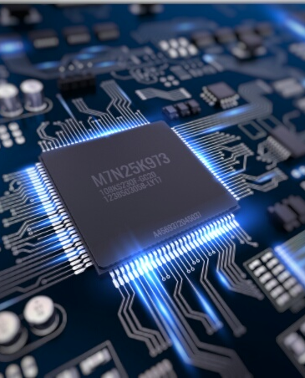
What is an FPGA?
Stands for "Field Programmable Gate Array"
Used in UCLA undergraduate coursework in CS M152A
Can be thought of as a "programmable circuit"
Useful for prototyping specialized chips (fancy word is application-specific integrated circuits, or ASICs)

Slide 11
What is a High-Level Synthesis (HLS) compiler?
C code
HLS Compiler
FPGA Code / executable / other FPGA related source
An HLS compiler compiles C or C++ (or a different high-level language) into FPGA-related source code or executable, typically into VHDL or Verilog code.
The C code is typically some smaller subset of the C standard, sometimes with additional features or required definitions

Slide 12
Can we use Csmith to test HLS compilers?

Slide 13
intel i++ / Dpcpp
The tool:
i++ is the most widely used and supported HLS compiler.
dpcpp is Intel's catch-all "one API" compiler that also provides an HLS compiler.
They are, for our purposes, identical (and quite possibly, dpcpp simply runs i++ with the right flags).

Slide 14
Some initial progress tracking
Installation of CSmith
Attempted installation of a number of HLS compilers
First successful HLS compiler installation: InstantSOC
Some initial failures with InstantSOC
ROCCC was also installed and found to be complex in its limitations and highly specific formatting
An effort was made to locally install Intel's i++ in which at first only one of the four of us could get i++ working on our device
We switched to using Intel's devcloud, but it did not have i++ and had dpcpp instead. Until further investigation we did not find that dpcpp could accomplish the same things as i++
We reasoned to use both in the end, once we had two machines that could run i++
Finally, at this point, we were able to make more productive steps toward the project's goals

Slide 15
The Intel subset of c99
Intel's i++ and dpcpp (and most other HLS compilers) do not support:
Dynamic memory allocation.
Virtual functions.
Function pointers
C++ or C library functions, except explicitly mentioned math functions.
Non-static class functions.
Template functions without an explicit specialization
Additional limitations on what loops are allowed
Some additional features specific to HLS

